Slide 1
HCI
User &
Usability
TS Cao Thái Phương Thanh
caothaiphuongthanh@gmail.com

Slide 2
Last content
Introduction to Design
Human – Computer interaction
Interactive design
Donald A. Norman’s design principles

Slide 3
Content
User
  Introduction
  Human information process model
  Cognitive process
Usability
  Concept
  Usability components
  Usability design guidelines

Slide 4
Users – Introduction
Human in HCI
Human: the purpose – ultimate target of all systems.
Understand users:
  Ability
  Habits
  Errors & mistakes
  Cognitive process
in using interactive systems

Slide 5
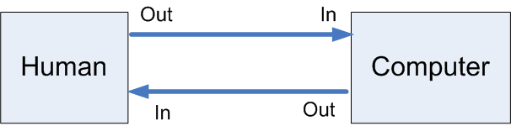
Users – Processing information system model
Human – Processing information system model
  Input / Output
  Memory
  Processor
Notes:
Liên hệ với máy tính

Slide 6
Users – Processing information system model
Input
  Looking
  Hearing
  Touching
Output
  Hand
  Others
Notes:
Looking
Hearing
Hand

Slide 7
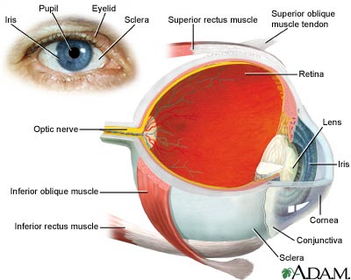
Users – Processing information system model
Looking:
Has most effect on GUI
Notes:
Looking
Hearing
Hand

Slide 8
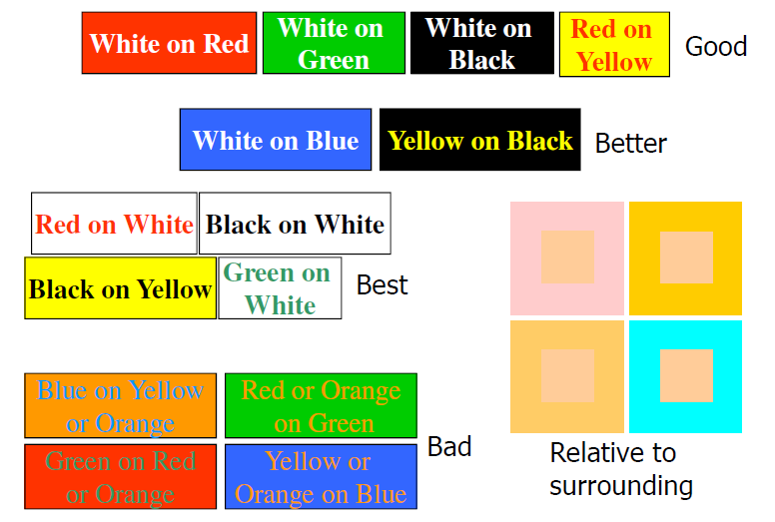
Users – Processing information system model
Looking: design with colors
Notes:
Looking
Hearing
Hand

Slide 9
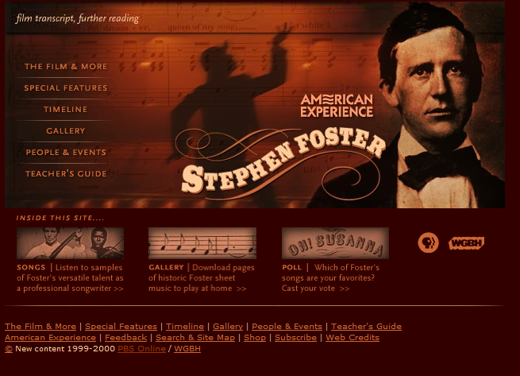
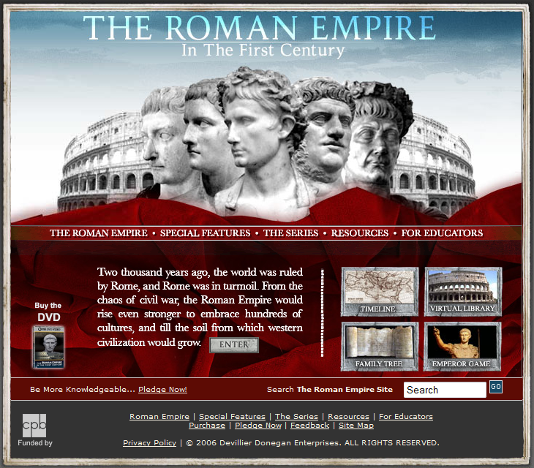
Users – Processing information system model
Looking: design with colors
Notes:
Looking
Hearing
Hand

Slide 10
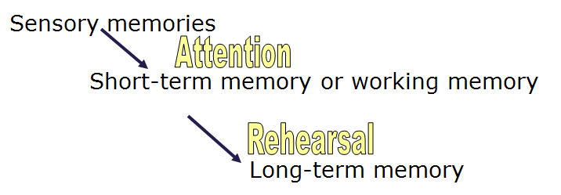
Users – Processing information system model
Memory
Notes:
Sensory memories: bộ nhớ giác quan, truy cập nhanh, quên nhanh
Long-term memory: nơi lưu kiến thức
→ Vd nhớ cách lập trình vòng lặp, nhớ từ khóa NNLT

Slide 11
Users – Processing information system model
Processor
  Reasoning
  Problem solving
  Skills training
  Error processing
→ Think → Cognition
Notes:
Reasoning: suy luận

Slide 12
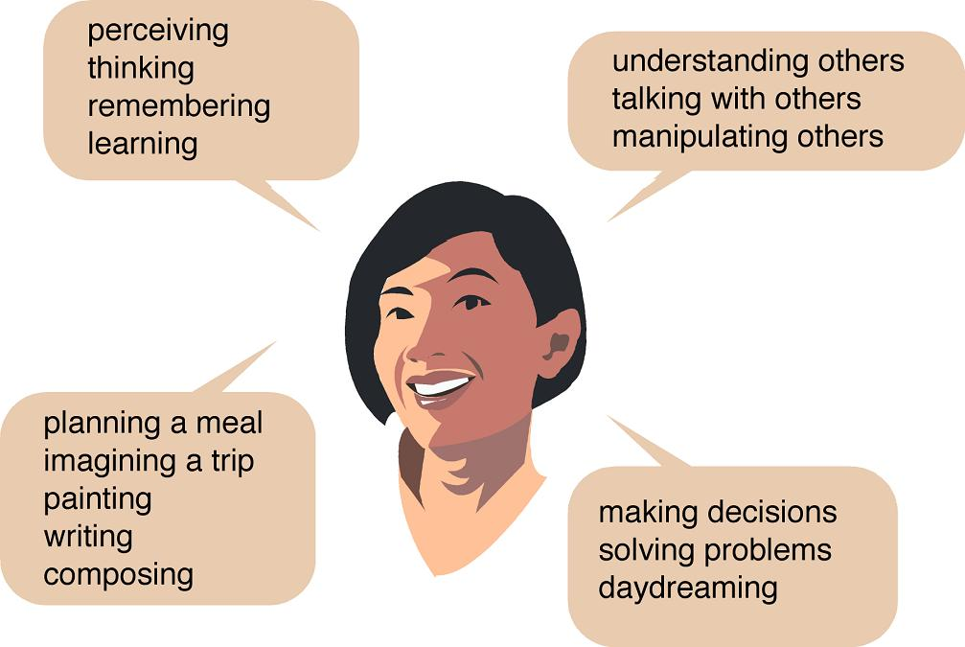
Users – Cognition
Notes:
What is cognition?
What are users good and bad at?
Describe how cognition has been applied to interaction design
Theories of cognition
Mental models, theory of action
Information processing
External cognition, distributed cognition

Slide 13
Users – Cognition
Cognition: the process by which we become acquainted with things, or how we gain knowledge.
Core cognitive processes for HCI:
  Attention
  Perception
  Memory
  Learning
Notes:
Not an exact model of how the brain operates, but provides a useful approximation for understanding and estimating certain kinds of actions and reactions

Slide 14
Users – Cognition : attention
Attention:
  Selecting things to concentrate within multi-things
  Involve visual senses
  Eable to focus on relevant information but limit users to notice all events.

Slide 15

Users – Cognition : attention
Windows XP Control Pannel Categorization
Why do you think printers were singled out?
User experiments show that printer configuration was a very common reason for visiting the Control Panel
Support users find the links quickly.

Slide 16
Users – Cognition : attention
Users pay attention to:
status bar ?
mouse cursor ?
There’s an amusing story about a user study mainly involving ordinary spreadsheet editing tasks, in which every five minutes the status bar would display “There’s a $50 bill taped under your chair. Take it!”
In a full day of testing, more than a dozen users, nobody took the money.

Slide 17
Users – Cognition : attention
Design for Attention:
  To help users focus on their tasks
  Technique:
    Color
    Ordering
    Spacing
    Animation
    Audio
    → Avoid over-use
  Use alerts only when necessary

Slide 18
Users – Cognition : Perception
Perception: ~ recognize
  to become aware of (something) through the senses
  uses different sense: vision, hearing, touch
Notes:
Perception & recognition: cảm thấy, nhận thấy, quen với

Slide 19
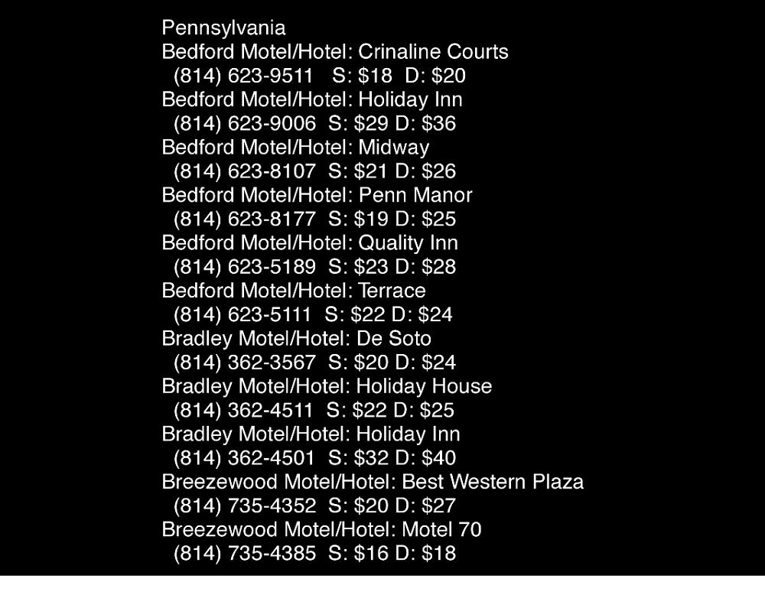
Users – Cognition : Perception
E.g. hotel information

Slide 20
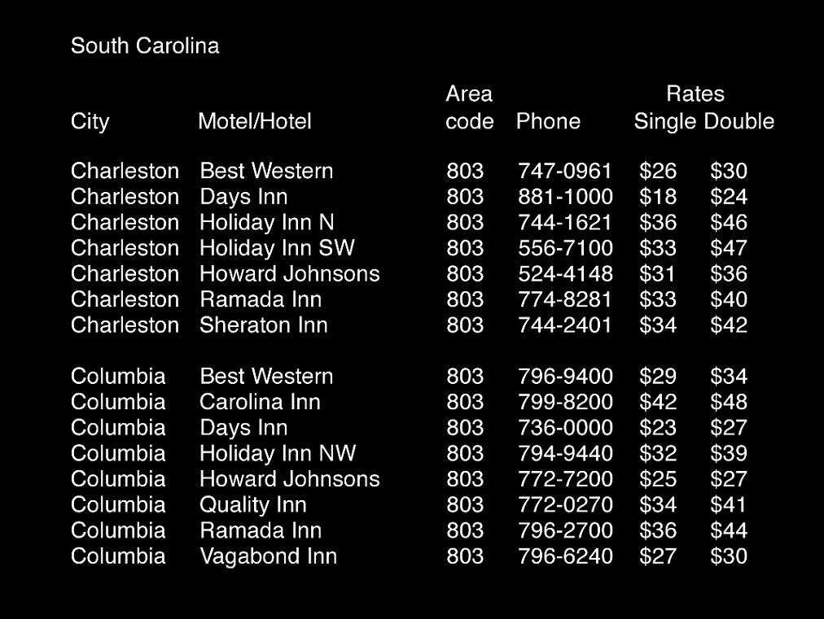
Users – Cognition : Perception
E.g. hotel information

Slide 21
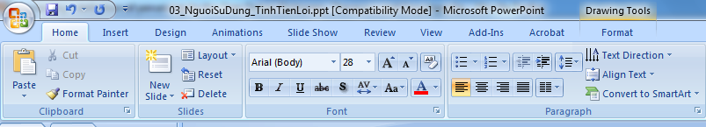
Users – Cognition : Perception
E.g. similar icons - ribbon

Slide 22
Users – Cognition : Perception
Design for perception
  Text should be readable
  Icons & graphical objects should allow users to distinguish their meanings.
  Sound should be audiable and meaningful
  Bordering & spacing are effective techniques.

Slide 23
Users – Cognition : Memory
Memory:
  Recalling knowledge that allow users to act rightly
  Users do not remember everything but filter & memorize what they attend & perceive.
  Context is important in affecting memory
  Human is better at recognizing then recalling
    Images better than words
    DOS vs Windows
Notes:
recognize: to identify as something or someone previously seen, known
recall: to bring back from memory

Slide 24
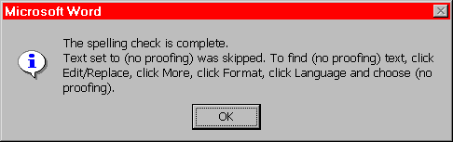
Users – Cognition : Memory
e.g. bad
How can users follow this guide after closing the dialog box?

Slide 25
Users – Cognition : Memory
Design for Memory:
  Do not overload users with complicated procedures
  Support recognition by using consistent menus, icons, and functions
  Provide various ways to help users organize & remember information. (e.g. color, flagging, category)

Slide 26
Users – Cognition : Learning
Learning:
  how to use computer application to complete the task
  users feel hard to learn from manuals (& usually ignore)

Slide 27
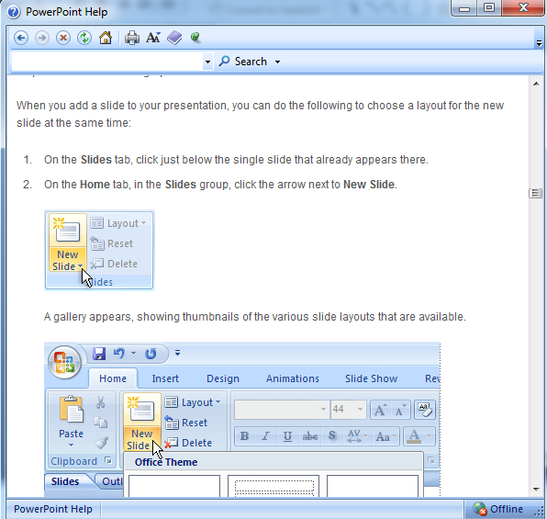
Users – Cognition : Learning
e.g. good ?

Slide 28
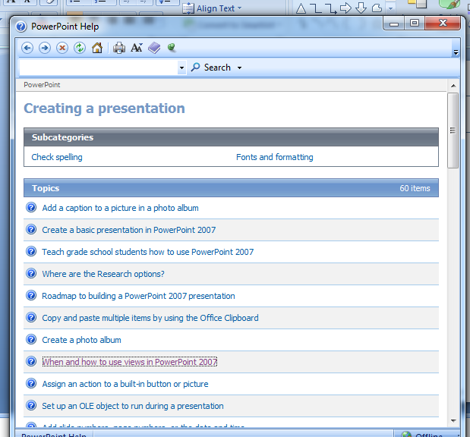
Users – Cognition : Learning
e.g. ?
Notes:
Too many topics → how to improve

Slide 29
Users – Cognition : Learning
Design for Learning:
  Multimedia help
  Learning through doing
  UNDO is important
  Design interface that encourage exploration
  Design interface that constrain errors

Slide 30
Users
Human – User is center of all systems
Understand users to design for users
Apply cognitive psychology into interactive design: emerging & important science.

Slide 31
Content
User
  Introduction
  Human information process model
  Cognitive process
Usability
  Concept
  Usability components
  Usability design guidelines

Slide 32
Usability
Usability: a quality attribute that assesses how well users can learn and use a product to accomplish their tasks and how satisfied they are with that process.
Usability is combination of many quality components:
  Effective
  Efficient
  Safe
  Learnable
  Memorable
  User satisfied
  …
Notes:
Thi: usability
Giới thiệu include tầm quan trọng

Slide 33
Usability is hard
Poor usability:
  Decrease productivity
  Make errors & mistakes
  Make users angry & frustrated
Failed product
Notes:
Thi: usability
Giới thiệu include tầm quan trọng

Slide 34
Usability is hard
Users are all different & unpredictable and they use systems via user interface.
User interface account ~50% of:
  Design time
  Implementation time
  Maintenance time
  Code size
Usability depends on users:
  Novice users need learnable
  Infrequent users need memorizable
  Experts need efficient

Slide 35
Usability is hard
Programmers are (usually) poor at usability:
  Do not think as “normal” people
  Know the technology/software internals first
  Enjoy systems more than people
  Arrogant & stubborn (“This is my software!”)

Slide 36
Usability is hard
Usability is an attribute (among others) of the system:
Functionality
Usability
Performance
Reliability
Security
Compatability
Tradeoffs among different attributes
Notes:
Thi: usability
Giới thiệu include tầm quan trọng

Slide 37
Usability components – Usability goals
Effectiveness
Efficiency
Safety
Learnability
Memorability
Satisfaction – User experience goals
…
Notes:
Usability goals:
Set criteria before designing
Measure quality of design (during evaluation)
Compare different designs

Slide 38
Usability goals - Effectiveness
How accurately and completely users can accomplish tasks
Provide enough functions for users to complete their tasks
Directly linked to user needs

Slide 39
Usability goals - Efficiency
How quickly users complete tasks.
If users have learned how to use a system, they should gain high productivity.
Minimal steps.
Time constraint.
Notes:
Time constraint: Consider task completion unsuccessful if not completed by a reasonable amount of time

Slide 40
Usability goals - Safe
Prevent users from making errors
Undo mechanism
Data security

Slide 41
Usability goals - Learnability
Sufficient user manual & tutorials
Easy and quick to learn
Ten-minute rule
Notes:
Notice:
+ Users are impatient
+ Manuals are boring

Slide 42
Usability goals - Memorability
How easy to remember procedures of systems
Should follow conventions
Clues for infrequently-used functions

Slide 43
Usability goals – Satisfaction – User experience goals
Designs affect users’ emotions
Less clearly defined → hard to assess
Example:
  Fun; Enjoyable; Pleasure; Motivating; Creative
  Boring; Annoying; Frustrating
→ Might become key advantage in design

Slide 44
Usability design guidelines
Donald A. Norman:6 Principles of Design
Shneiderman: 8 Golden Rules of Interface Design
Jacob Nielsen: 10 Usability Heuristics
Notes:
Notice:
+ Users are impatient
+ Manuals are boring

Slide 45
Donald A. Norman: Principles of Design
Siginifier
Affordance
Constraint
Mapping
Feedback
Conceptual model

Slide 46
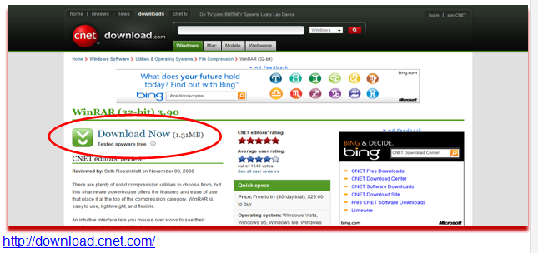
Donald A. Norman: Principles of Design
1. Signifier : vd tốt : …
Notes:
Bài tập năm ngoái : không phải bài tốt nhất

Slide 47
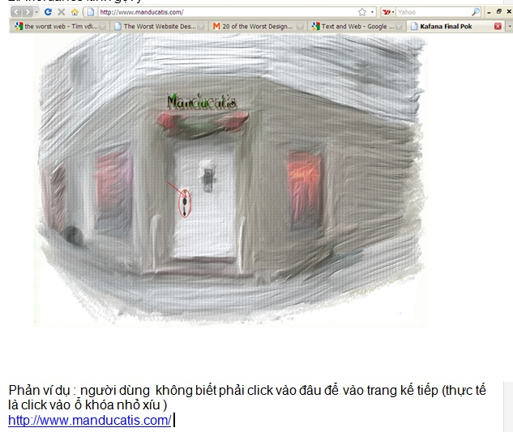
Donald A. Norman: Principles of Design
2. Affordance: vd kém : …

Slide 48
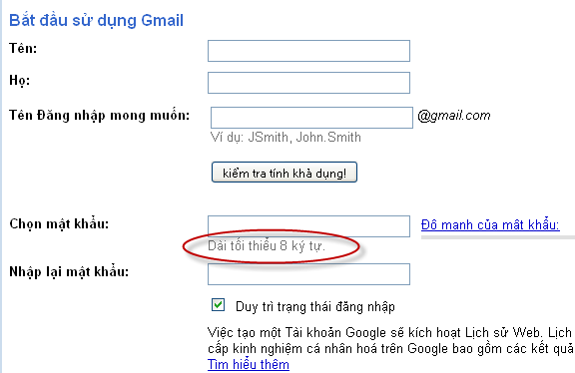
Donald A. Norman: Principles of Design
3. Constraint : vd tốt

Slide 49
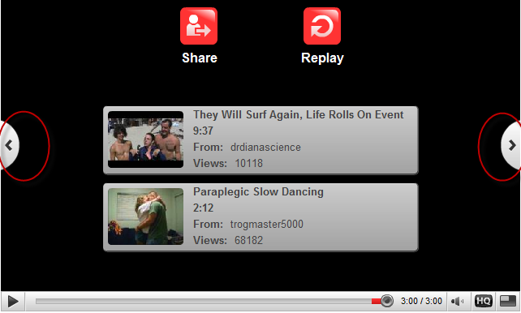
Donald A. Norman: Principles of Design
4. Mapping: vd tốt

Slide 50
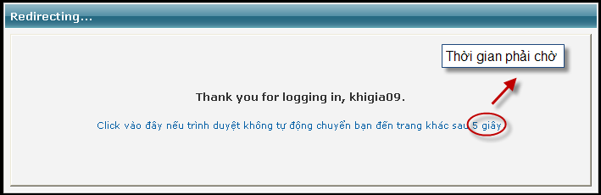
Donald A. Norman: Principles of Design
5. Feedback: vd tốt

Slide 51
Shneiderman: 8 Golden Rules of Interface Design
Strive for consistency
Enable frequent users to use shortcuts
Offer informative feedback
Design dialogs to yield closure
Offer error prevention and simple error handling
Permit easy reversal of actions
Support internal locus of control
Reduce short-term memory load
Notes:
Design dialogs to yield closure: Organized sequences of actions into groups with a beginning, middle, and end.
Design dialogs to yield closure such that the user is aware that specific actions have been concluded and next activities may now take place.
Locus of Control: Do you believe that your destiny is controlled by yourself or by external forces (such as fate, god, or powerful others)?

Slide 52
Jacob Nielsen: 10 Usability Heuristics
Visibility of system status.
Match between system and real world.
User control and freedom.
Consistency and standards.
Error Prevention.

Slide 53
Jacob Nielsen: 10 Usability Heuristics
Recognition rather than recall
Flexibility and efficiency of use
Aesthetic and minimalist design
Help users recognize, diagnose, and recover from errors
Help and Documentation

Slide 54
Reference
http://www.useit.com/
  http://www.nngroup.com/articles/usability-101-introduction-to-usability/
http://www.usability.gov/
Good online dictionary: http://dictionary.reference.com/
Notes:
Lưu ý: học tiếng Anh: nếu thấy khó không học, thì không bao giờ học được

